Slide 1

Welcome you all
JavaScript
Chitradevi M
Technical Trainer
KGiSL Micro College
KGiSL Campus, Coimbatore – 641 035.

Slide 2
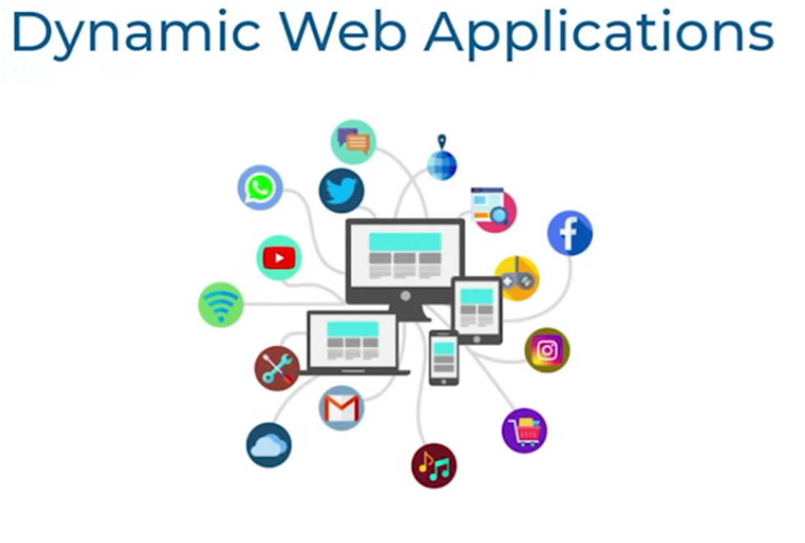

Slide 3
Difference between static and dynamic web pages
A static website contains simple HTML pages and supporting files (e.g., Cascading Style Sheets (CSS), JavaScript (JS)) hosted on a web server.
When a site visitor requests a static page, say, by clicking a link, selecting a browser bookmark, or entering a URL;
the web server sends the page directly to the web browser without modifying the final content of the page.

Slide 4
Dynamic web pages
A dynamic page displays different content for different users while retaining the same layout and design.
Such pages, usually written in CGI, AJAX, ASP or ASP.NET, take more time to load than simple static pages.
They’re frequently implemented to show information that changes frequently, e.g., weather updates or stock prices.
Dynamic pages usually contain application programs for different services and require server-side resources like databases.
A database allows the page creator to separate the website’s design from the content to be displayed to users. Once they upload content into the database, it is retrieved by the website in response to a user request.

Slide 5
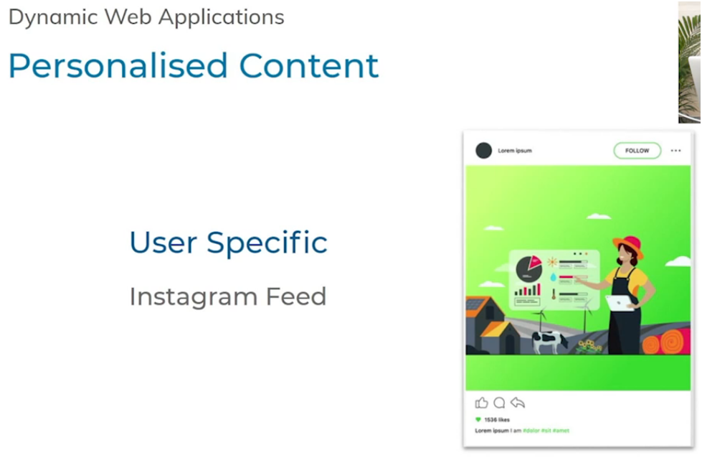

Slide 6


Slide 7
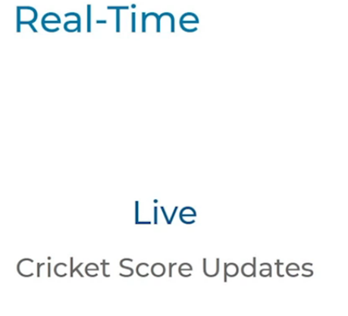

Slide 8
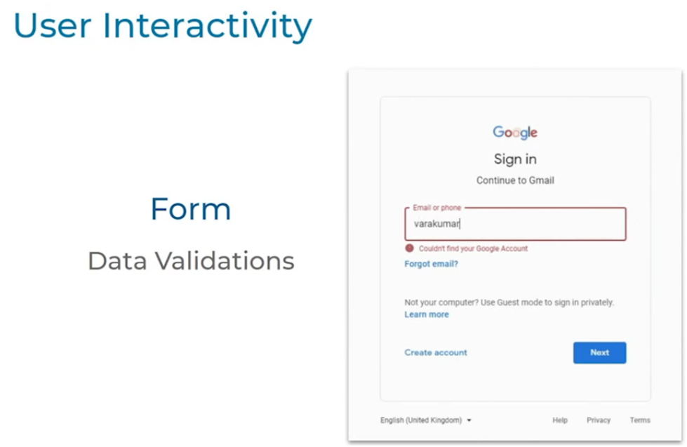

Slide 9
JavaScript
JavaScript is used to create client-side dynamic pages.
JavaScript is an object-based scripting language which is lightweight and cross-platform.
JavaScript is not a compiled language, but it is a translated language. The JavaScript Translator (embedded in the
browser) is responsible for translating the JavaScript code for the web browser.

Slide 10
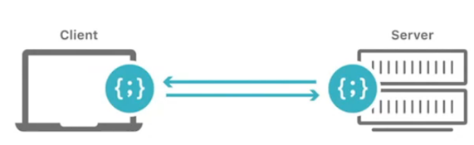
Building Dynamic Web Applications mainly involves:
Client Server Communication
Manipulating HTML and CSS
Writing Application Logic
Client-side validation,
Dynamic drop-down menus,
Displaying date and time,
Displaying pop-up windows and dialog boxes (like an alert dialog box, confirm dialog box and prompt dialog box),
Displaying clocks etc.

Slide 11

Ways to achieve
Using JavaScript
Using Web Assembly
Understood by Major Browsers
JavaScript is the most popular programming languages which is adopted and understood by all the major Browsers.
Companies Using JavaScript

Slide 12
JavaScript(JS)
HTML provides the basics structure for web pages.
CSS is used for Styling.
JS is used primarily by web browsers to create a dynamic and interactive experience for the users.
JavaScript can be used in both client-side and server side.
Buttons Animations
Live Dashboards
Games

Slide 13
Your First Program
Displaying a Message
Writing a program to display “Welcome to KGM”
Console.log(“Welcome to KGM”)
Code | Possible Mistake
consolelog(“Hai”); | Missing .between
Console.log(“Hai”); | Uppercase ‘C’ in console
Console.log(Hai) | Missing quotes
Console.log(“Hai” | Missing Parentheses

Slide 14
Running JavaScript Code using Browser Console
Run the .html file right click Inspect console
JavaScript example is easy to code. JavaScript provides 3 places to put the JavaScript code:
within body tag, within head tag and external JavaScript file.
The script tag specifies that we are using JavaScript.
The text/JavaScript is the content type that provides information to the browser about the data.
The document.write() function is used to display dynamic content through JavaScript. We will learn about document object in detail later.

Slide 15
3 Places to put JavaScript code
Between the body tag of html
Between the head tag of html
In .js file (external JavaScript)

Slide 16
code between the body tag
<html>
<body>
<script type="text/javascript">
alert("Hai Students ");
</script>
</body>
</html>

Slide 17
code between the head tag
<html>
<head>
<script type="text/javascript">
function msg(){
alert("Welcome to Kgisl");
}
</script>
</head>
<body>
<p>Welcome to Javascript</p>
<form>
<input type="button" value="click" onclick="msg()"/>
</form>
</body>
</html>

Slide 18
External JavaScript file
We can create external JavaScript file and embed it in many html page.
It provides code re usability because single JavaScript file can be used in several html pages.
An external JavaScript file must be saved by .js extension. It is recommended to embed all JavaScript files into a single file. It increases the speed of the webpage.
Index.html
<html>
<head>
<script type="text/javascript" src="msg.js"></script>
</head>
<body>
<p>Welcome to JavaScript</p>
<form>
<input type="button" value="click" onclick="msg()"/>
</form>
</body>
</html>
Script.js
function msg(){
alert("Hello Kgisl");
}

